Slide 1
Natural Gas and Electricity Interface Challenges in New England
Restructuring Roundtable
Boston, MA
November 15, 2013
Donald F. Santa
President & CEO
Interstate Natural Gas Association of America

Slide 2
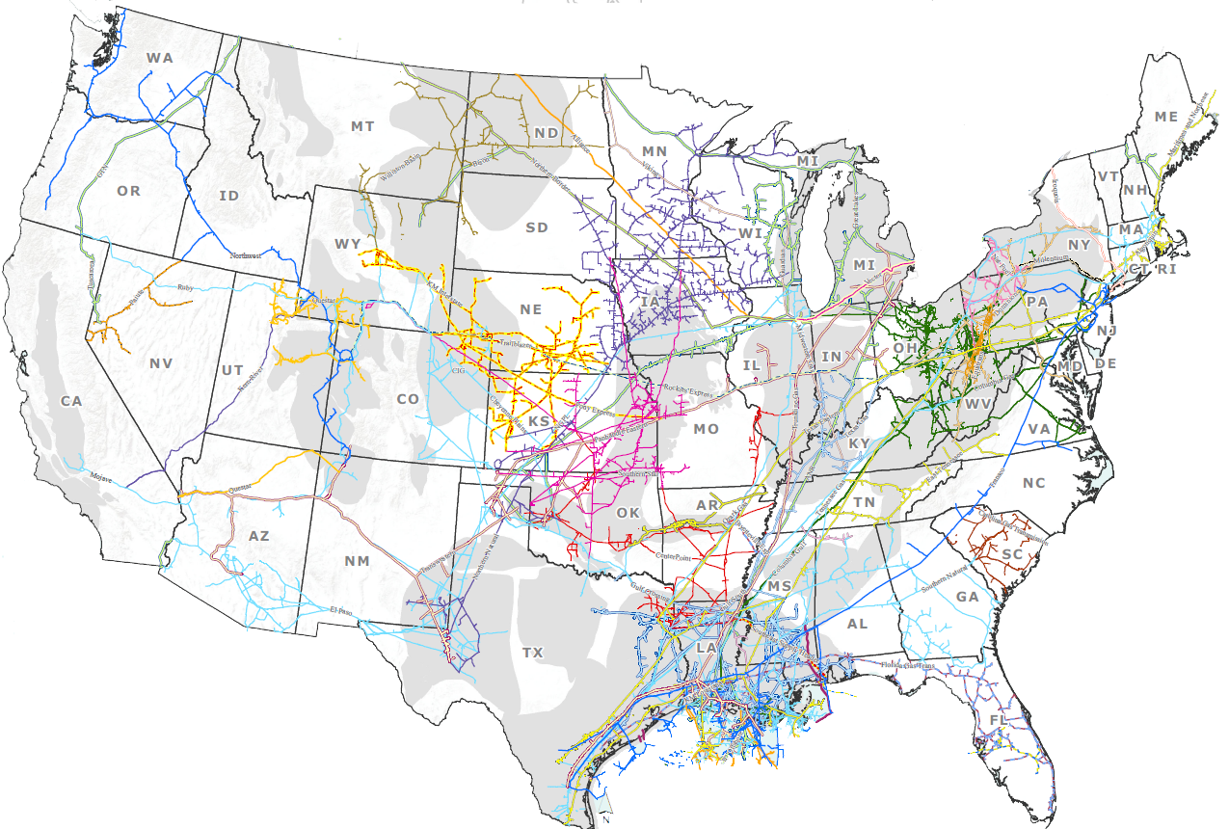

U.S. Natural Gas Transmission Pipelines:
A Robust Infrastructure
Source: Interstate Natural Gas Association of America, Pennwell MapSearch

Slide 3
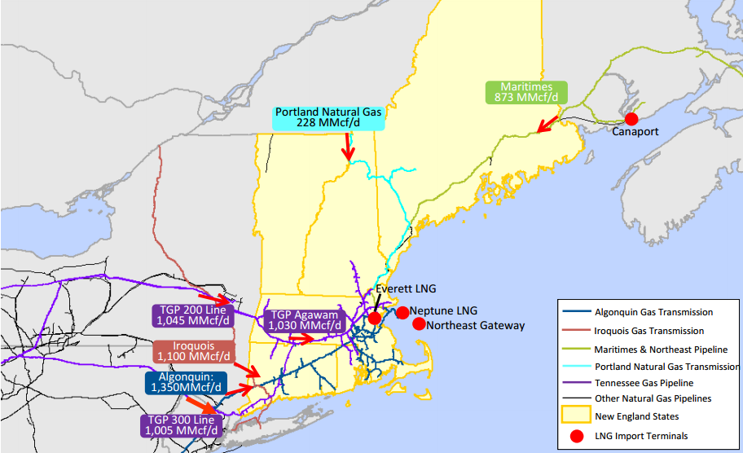
Existing Pipeline Infrastructure in New England
Source: Black & Veatch

Slide 4
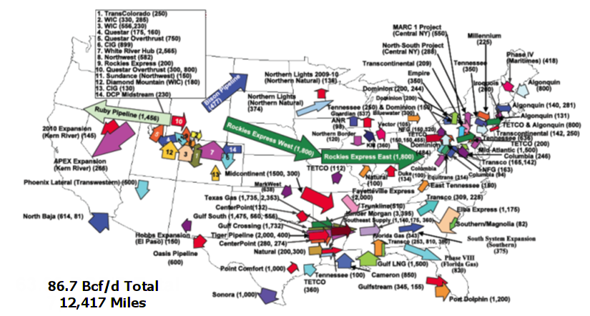
Proven Track Record of Building Pipeline Infrastructure:
12,400 Miles Added Between January 2003 and March 2013
Source: FERC, Office of Energy Projects

Slide 5
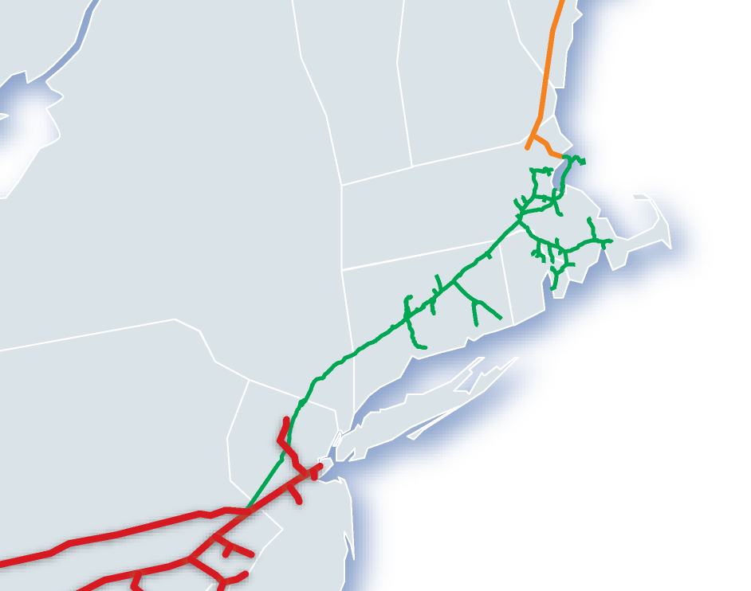


The Region Needs More Pipeline Capacity
Texas Eastern
Algonquin
Maritimes & NE
Millennium
Iroquois
Tennessee Gas
NEW ENGLAND
2008-09
$6.99/dth
2011-12
$3.99/dth
2012-13
$9.62/dth
PRICE PREMIUM
2008-09
$0.24/dth
BOSTON
2011-12
$0.92/dth
2012-13
$5.57/dth
IN the FUTURE: Infrastructure needed to get supplies to market
BOTTLENECK
NEW YORK
MID-ATLANTIC
2008-09
$6.75/dth
2011-12
$3.07/dth
2012-13
$4.05/dth
Source: Spectra Energy

Slide 6

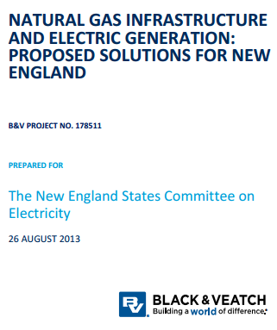
NESCOE Study:
Infrastructure Constraints Threaten
Regional Electric Grid Reliability
In the absence of infrastructure or other solutions to increase supply or reduce demand, New England will experience significant natural gas infrastructure constraints. The constraints could dramatically increase wholesale natural gas and electricity prices throughout the region, and potentially threaten the integrity and reliability of the regional electric grid.
Black & Veatch Proposed Solutions:
Cross-Regional Natural Gas Pipeline
Electric Transmission Options
Source: Black & Veatch

Slide 7
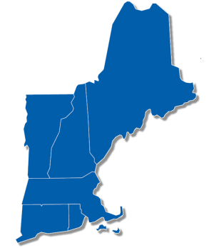
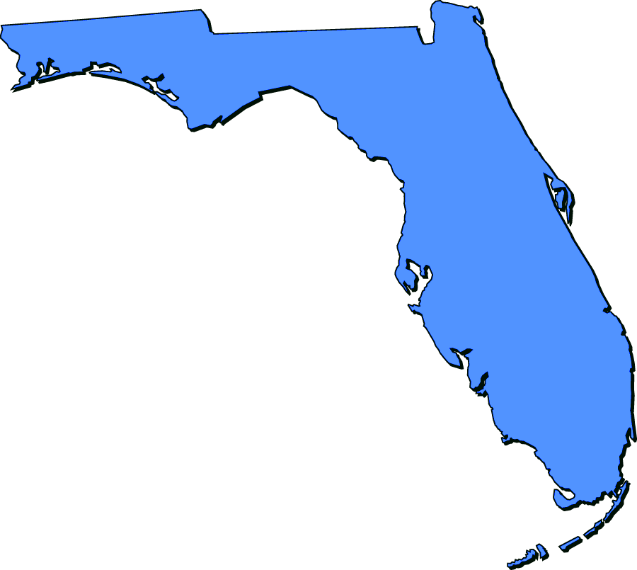
Market Conditions &
Incentives by Region
 | New England | Florida
Limited Pipelines | ✓ | ✓
Dependent on Natural Gas | ✓ | ✓
Region Located on the End of Infrastructure | ✓ | ✓
Ability to Pass Through Electric Reliability Cost | ✗ | ✓
Fully Subscribed Pipeline Expansion | ✗ | ✓

Slide 8
Why New England should care about this
Current framework is unsustainable
ISO’s pay for performance FCM incentive is unlikely to be enough
Projected consumer benefits depend on sufficient energy infrastructure
Reliability implications
Something has got to give

Slide 9
Contact Information
Donald Santa
President and CEO
Interstate Natural Gas Association of America
20 F Street N.W., Suite 450
Washington, D.C.
202.216.5901
dsanta@ingaa.org
www.ingaa.org

